Slide 1
The effect of artificial light spectrum on mate attraction in the common glow-worm, Lampyris noctiluca by Linnea Kivelä
CSE713: Individual Presentation
Group No-12
ST: Ehsanur Rahman Rhythm
RA: Md Sabbir Hossain
Individual Presenter :
Saikat Halder Tuhin 22266021
Submitted To:
Annajiat Alim Rasel
Senior Lecturer, Department of Computer Science and Engineering,
Brac University.

Slide 2
Introduction
Artificial light at night (ALAN) is a globally occurring threat to wildlife, which has emerged relatively recently with the expansion of human industrialisation and is currently still increasing worldwide by 6% every year
A particular group of nocturnal animals that are especially vulnerable to artificial light are the bioluminescent glow-worms and fireflies (Lampyridae), due to their light based signals for mating
Studies have found that artificial lights has caused reduced circadian glowing activity in female glow-worm and as they have short mating period and many of them die without mating, which eventually decreases the population of glow-worms.
This study aims whether certain colors of artificial light interfere with the ability of male glow-worms to locate glowing females, or of glowing females to attract males, to a different degree than others.

Slide 3
Methods and Materials
2 experiments were conducted:
by monitoring male glow-worms attracted to dummy females under different colored artificial lights in the field.
second experiment was decided upon midway through the conducting of the primary experiment.
All work was conducted at or nearby Tvärminne Zoological Station (N 59°51’, E 23°14’) in Southern Finland, in June-July 2020 during the glow-worm mating season.

Slide 4
Methods and Materials
Statistics:
All statistical analyses were performed using R v. 3.6.1. (R Core Team 2019) and RStudio v. 1.2.5001 (RStudio Team 2019) for macOS.
She investigated the effect of artificial light spectrum on the number of males attracted using a generalized linear model (GLM) with a negative binomial distribution.
She fitted the data with four different models using the same response and explanatory variables: a linear model, and GLMs with Poisson, zero inflated Poisson, and negative binomial distributions.
Lastly comparison among the performance of the models using model validation plots, dispersion, and Akaike information criteria (AIC, Akaike 1973) scores was done.

Slide 5
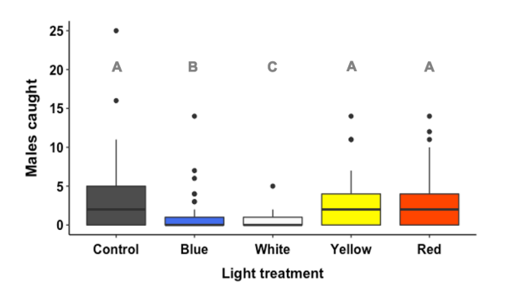
Experimental Result
During the experiment, 624 distinct male glow-worms were captured. Males were caught by traps in the white light treatment more frequently than in the blue and white light treatments, which caught much less males than the yellow, red, and control treatments. The number of males collected did not significantly differ between the yellow and red light treatments and the control group.
Figure 1. Number of males caught per trap in unilluminated (control) traps and in traps illuminated from above with blue, white, yellow and red artificial light. Box plots show median values (horizontal black lines), interquartile ranges (colored boxes), upper quartiles (whiskers), and extreme values (black dots).

Slide 6
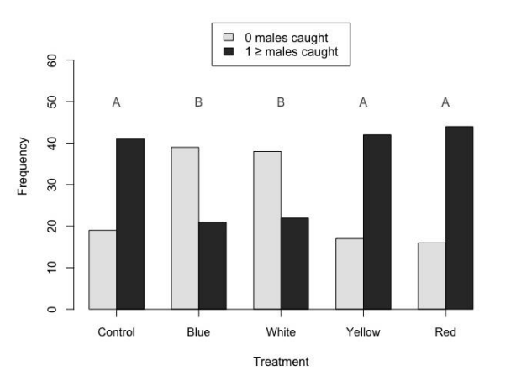
Experimental Result
A total of 57% of the traps during the experiment were successful in catching at least one male, with 170 instances of one or more males being caught and 129 instances of no males being caught. Compared to traps in the yellow, red, and control treatments, catching success was considerably lower in the blue and white light treatments. Between the blue and white light treatments as well as the yellow and red light treatments compared to the control, catching success did not significantly differ. Therefore, other than the fact that the difference between the blue and white light treatments was no longer significant, the results of the binary analysis were consistent with those obtained from the analysis utilizing the number of males.
Figure 2. Catching success of traps in the different light treatments. Black bars show the number of traps that successfully caught at least one male in each treatment, whereas light grey bars signify traps that failed to catch any males. Treatments with a different letter (A or B) were significantly different from each other (logistic regression). N = 60 in all treatments except the yellow-light treatment, where N = 59.

Slide 7
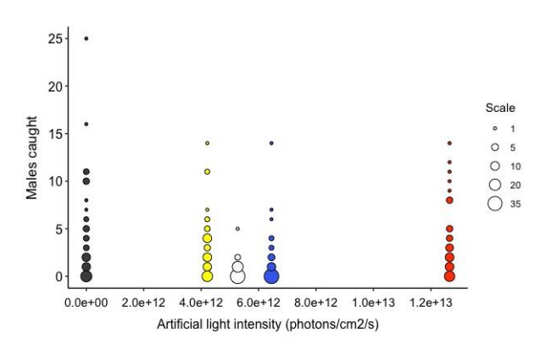
Experimental Result
The red light treatment, which had the maximum light intensity, had the second-largest number of males, whereas the control treatment, which had no artificial light at all, had the most males. Contrary to popular belief, the yellow light treatment had the lowest intensity light while having the next-largest catch sizes and no discernible change in catch size from the red and control treatments. The light intensity of the white light treatment, which had the smallest catch sizes, was halfway between that of the yellow and blue light treatments. As a result, the artificial light intensity alone cannot account for the variations in male attraction success between treatments; light color also must be a factor.
Figure 3. Male catch sizes plotted against artificial light intensity in the different treatments, measured as photons/cm2 /s. Point color corresponds to light color, and point size indicates number of observations; the larger the point, the more traps there were with a given number of males. Light intensity refers to the “extra light” from the artificial light source, with the measurements taken in an otherwise completely dark room.

Slide 8
Discussion
The findings demonstrate that the spectral composition of light affects mate attractiveness in common glow-worms.
The ability of dummy females to attract mates under yellow and red artificial light was identical to that of the control dummy females who were not illuminated.
With the exception that red light might not have an impact if male glow-worms are unable to sense it and that the detrimental effect would be stronger in the short wavelength treatments, mate attraction success would be lower in all artificial light treatments compared to the control.
It was found that mate attraction success in common glow-worms was less affected by long wavelength (yellow and red) artificial light than by short wavelength (blue and white) artificial light.
To conclude, research shows that the wavelength of artificial light has a significant role in defining the impacts of ecological light pollution on glow worms, with potentially significant consequences for the conservation of glow worms.

Slide 9
Reference
https://ethesis.helsinki.fi/repository/handle/123456789/40356

